Slide 1
USDA RURAL DEVELOPMENT
Single Family Housing 2024
Dr. Trina N. George
State Director
Nicole Barnes Deputy State Director
SFH Division State Office:
Ivan Kiani - Program Director
Stefanie Atkins-Granderson - Lead Realty Specialist
Starr Magee - Lead Realty Specialist
Rebecca Walden - Lead Realty Specialist
Briana Brooks - State Office Technician

Slide 2

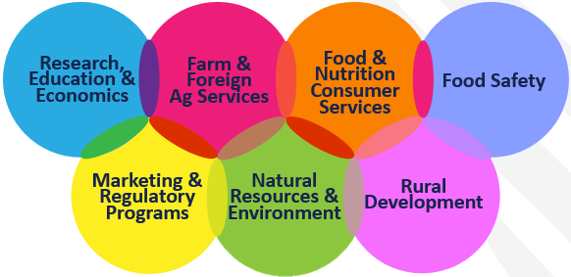
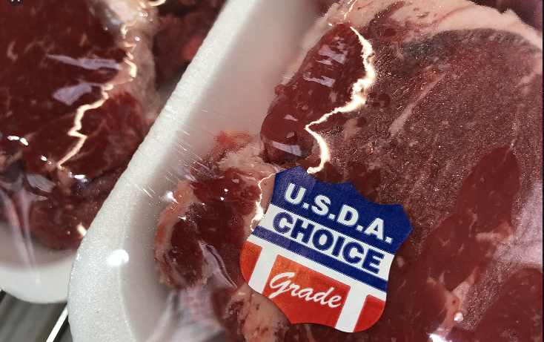
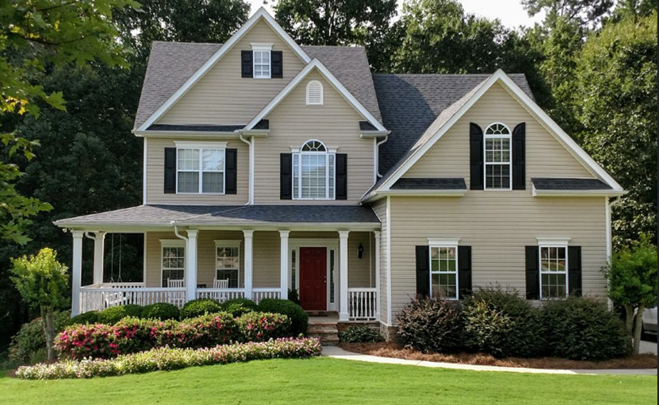
ABOUT USDA – More than meat inspection
One USDA, 7 Mission Areas
Notes:
Many people think of Meat Inspection when they hear “USDA”. We do much more than that!

Slide 3
Who is Rural Development?
In 1946 the Farmers Home Administration Act consolidated the Farm Security Administration (1937-1946) with the Emergency Crop and Feed Loan Division of the Farm Credit Administration - a quasi-governmental agency that still exists today.
Title V of the Housing Act of 1949 authorized the Department of Agriculture (USDA) to make loans to farmers to enable them to construct, improve, repair, or replace dwellings and other farm buildings to provide decent, safe, and sanitary living conditions for themselves or their tenants, lessees, sharecroppers, and laborers. USDA was also authorized to make grants or combinations of loans and grants to those farmers who could not qualify to repay the full amount of a loan, but who needed the funds to make the dwellings sanitary or to remove health hazards to the occupants or the community.
Between 1947 and 1994, the FmHA expanded the availability of credit and the size of loans. In its later years, the FmHA extended credit to individuals and communities for non-farm use. In 1994, the US Department of Agriculture was reorganized and the functions of FmHA were transferred to the Farm Service Agency. In 2006, the FmHA was fully terminated. Its housing and community programs were transferred to the newly formed USDA Rural Development.

Slide 4

SFH PROGRAMS
SECTION 502 GUARANTEED LOANS
SECTION 502 DIRECT LOANS
SECTION 504 DIRECT LOANS & GRANTS
SECTION 533 HOUSING PRESERVATION GRANTS
SECTION 523 SELF-HELP HOUSING GRANTS
SECTION 524 SITE LOANS

Slide 5
SFH INITIATIVES
504 DISASTER ASSISTANCE GRANTS PILOT
DIRECT LOAN/GRANT APPLICATION PACKAGING
EXISTING MANUFACTURED HOME PILOT PROGRAM

Slide 6
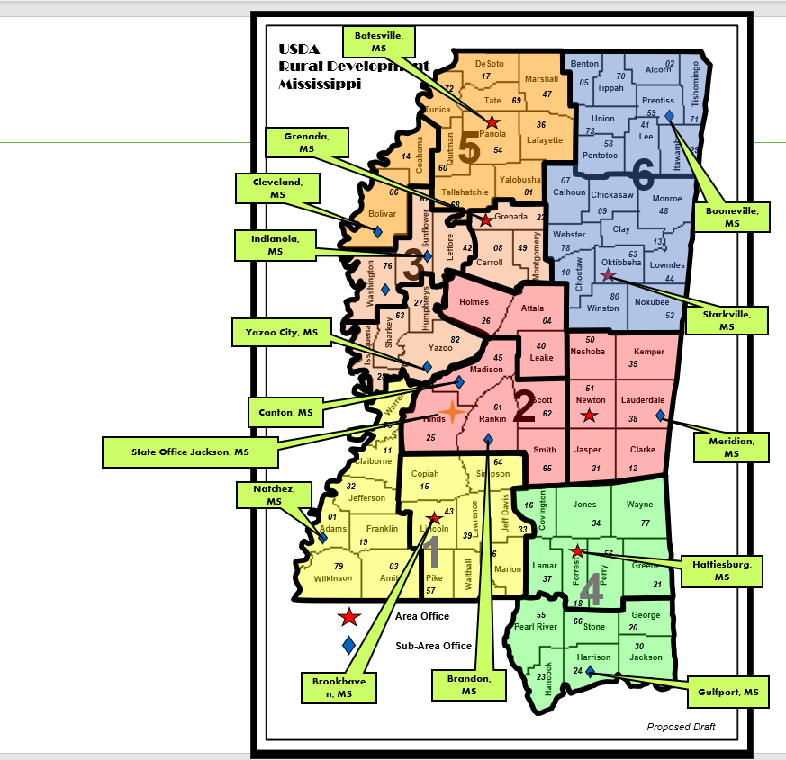
Biloxi

Slide 7
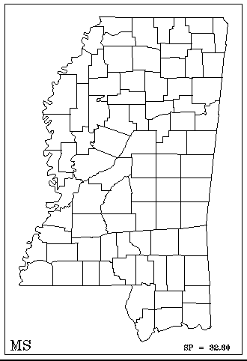
Mississippi USDA, RD
Team Concept
DeSoto
Benton
02
Team Leads
Starr Magee-1
Rebecca Walden-2
Stefanie Granderson-3
72
17
Marshall
05
70
Alcorn
69
47
Tippah
Tishomingo
Tunica
Tate
Prentiss
36
Union
59
71
Panola
73
41
14
3
54
Lafayette
58
Lee
29
Coahoma
Quitman
Pontotoc
Itawamba
60
07
06
Yalobusha
67
Tallahatchie
81
Calhoun
Chickasaw
68
09
Monroe
Bolivar
Grenada
22
48
Sunflower
42
08
49
Webster
Clay
13
Leflore
78
53
76
Carroll
Montgomery
10
Oktibbeha
Lowndes
Washington
Choctaw
44
27
Holmes
80
63
Humphreys
Attala
2
Noxubee
26
04
Winston
52
Issaquena
Sharkey
82
40
50
Yazoo
45
Leake
Neshoba
Kemper
28
Madison
35
51
Warren
61
Scott
Newton
Lauderdale
75
Hinds
Rankin
62
38
11
25
Claiborne
64
Smith
Jasper
Clarke
Copiah
Simpson
65
31
12
32
15
01
Jefferson
43
1
16
Jones
Wayne
Lawrence
Jeff Davis
Covington
34
77
Adams
19
Franklin
Lincoln
39
33
79
03
46
56
Marion
Lamar
Forrest
Greene
Wilkinson
Amite
Pike
Walthall
37
Perry
21
57
74
18
Area Office
55
66
George
Pearl River
Stone
20
Sub-Area Office
30
Harrison
Jackson
23
24
Hancock
Revised 6-5-23

Slide 8

Fiscal Year 2023
FY23 Dollar Obligated:
Section 502 Guaranteed loans $226.7 million assisting 1,321 families (14th nationally)
Section 502 Direct obligation $46,999,361.00 assisting 248 families (13th nationally)
Section 504 Direct obligations $ 3,169,207.00 assisting 325 families (2nd nationally)
Section 533 Housing Preservation Grants $ 724,938.00 assisting 7 Grantees
Total housing dollars obligated $277,558,363.00.00 assisting 1,977 rural MS families for FY23
Over $1.8 Billion in SFH funds obligated in MS over the last four (4) fiscal years
Historical High

Slide 9

Web Site
rd.usda.gov

Slide 10
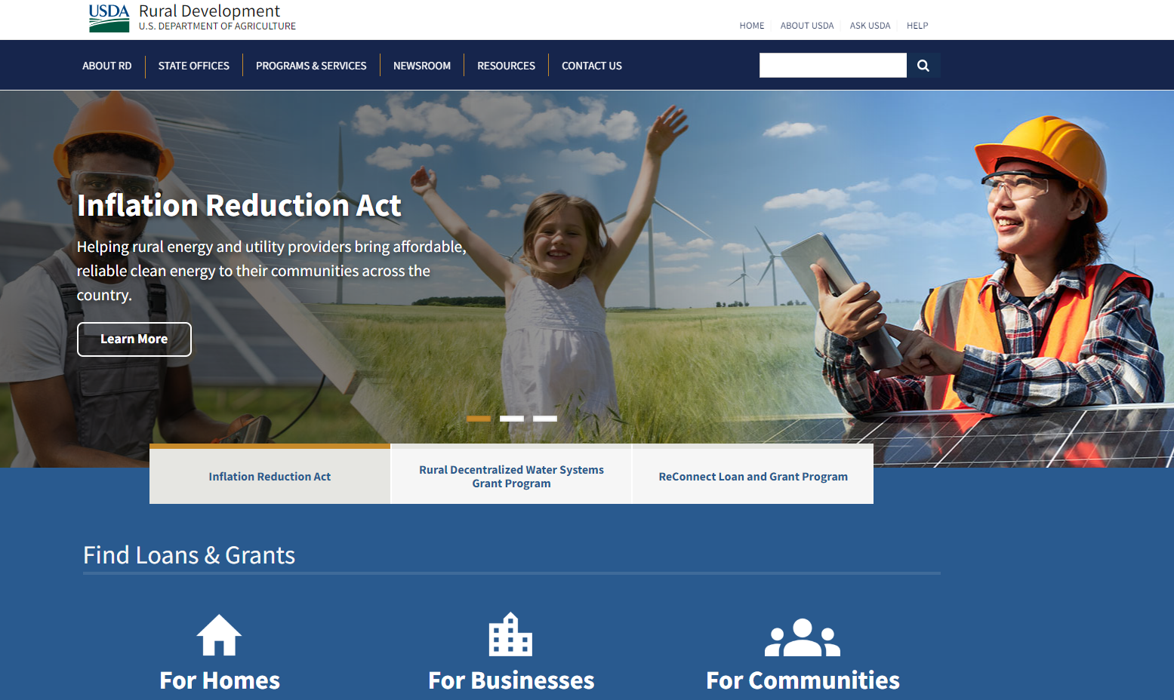
rd.usda.gov

Slide 11
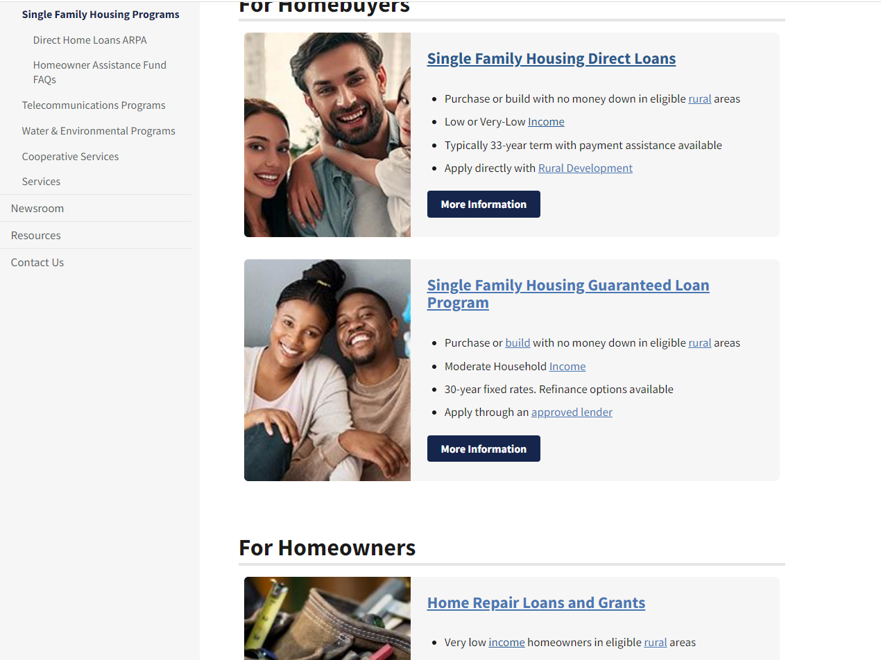

Slide 12


Slide 13
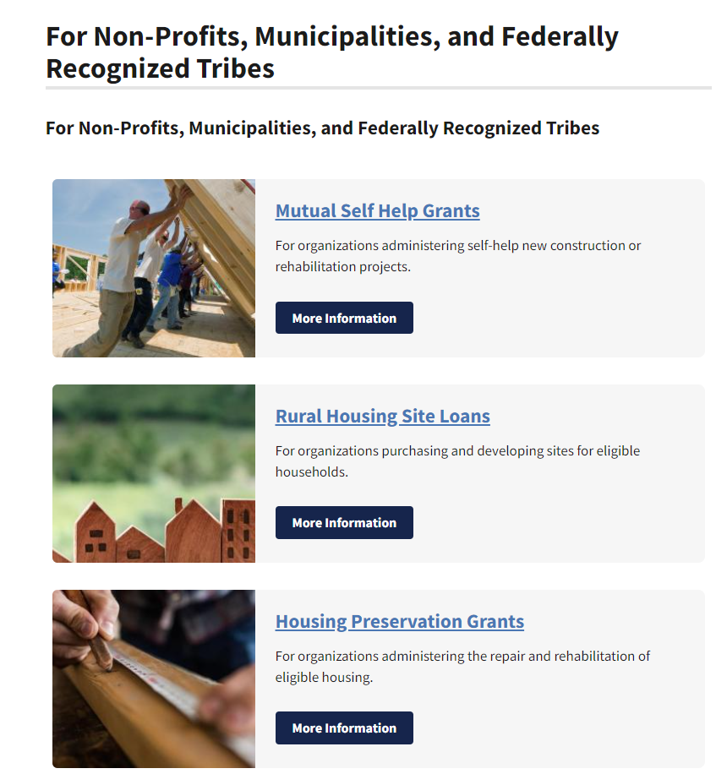

Slide 14
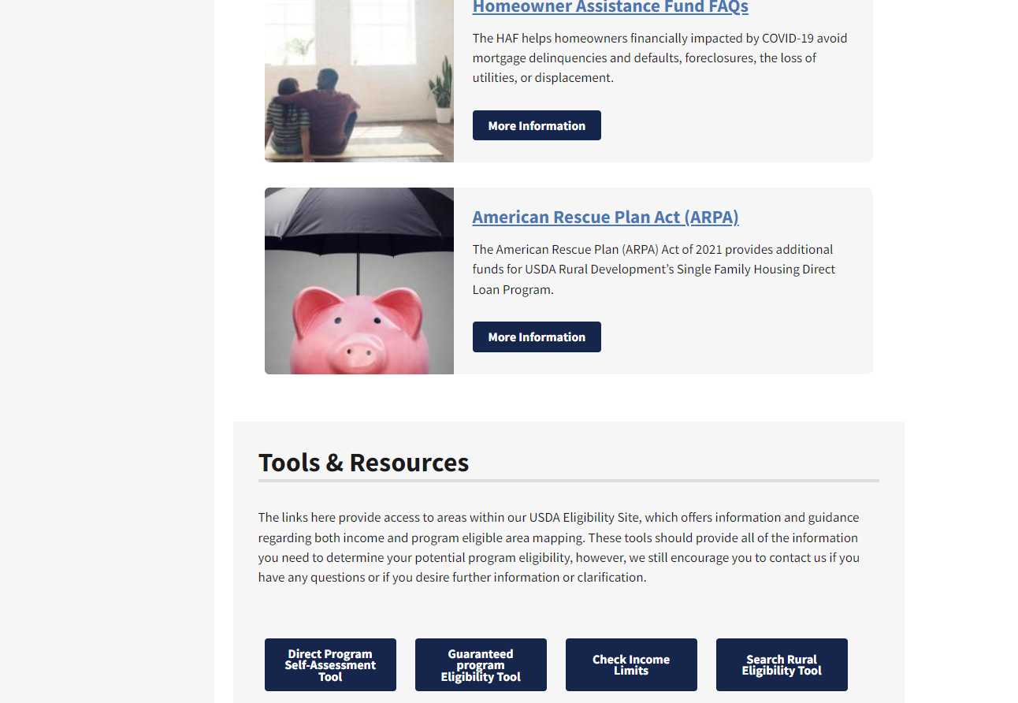

Slide 15
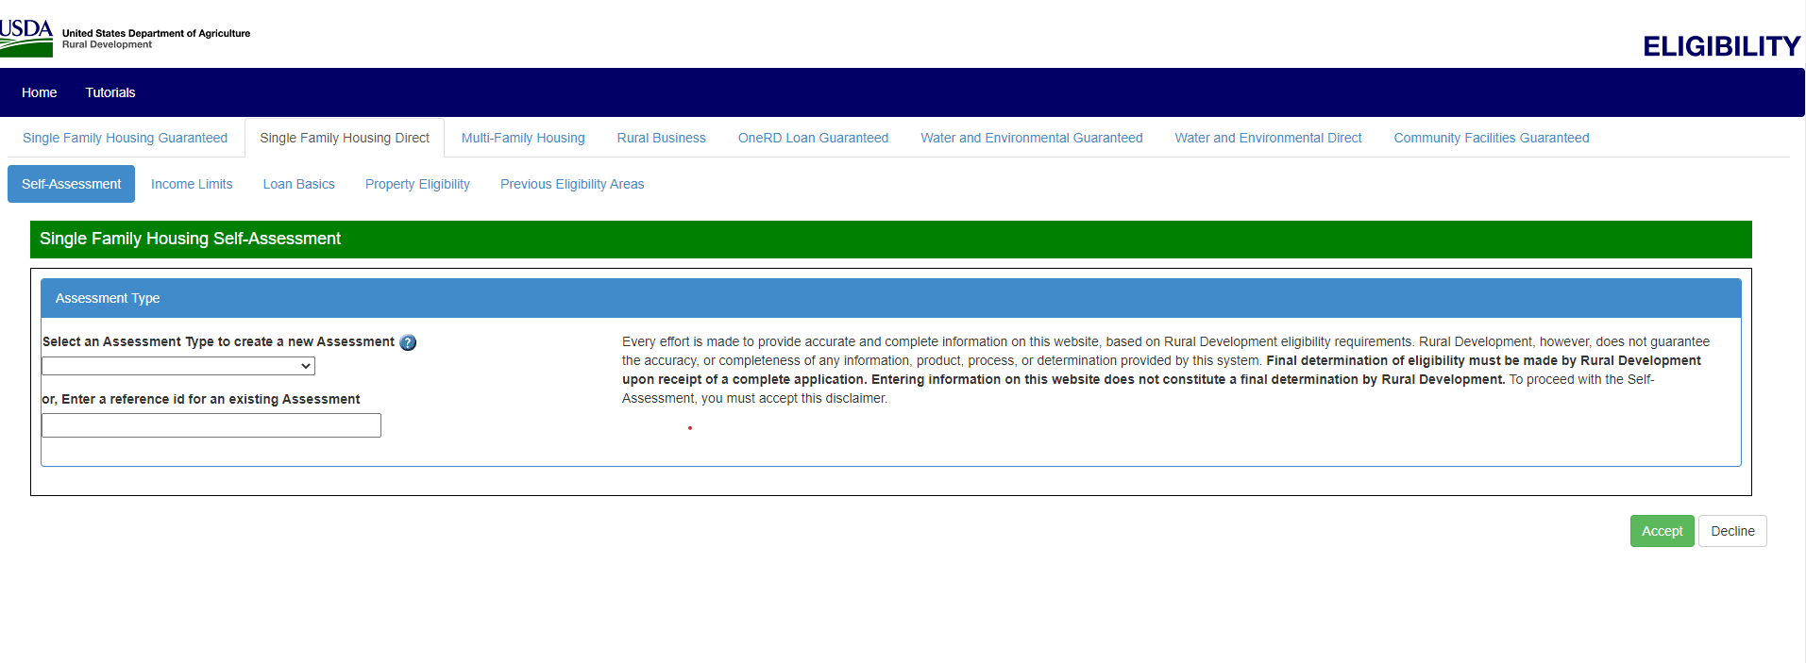
Encourage applicants to use Self-Assessment Tool

Slide 16
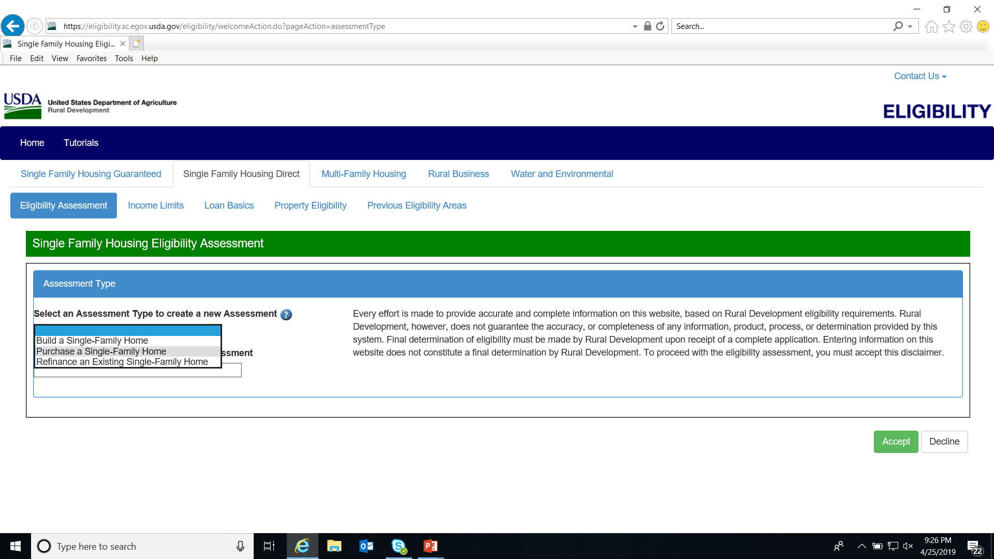

Slide 17
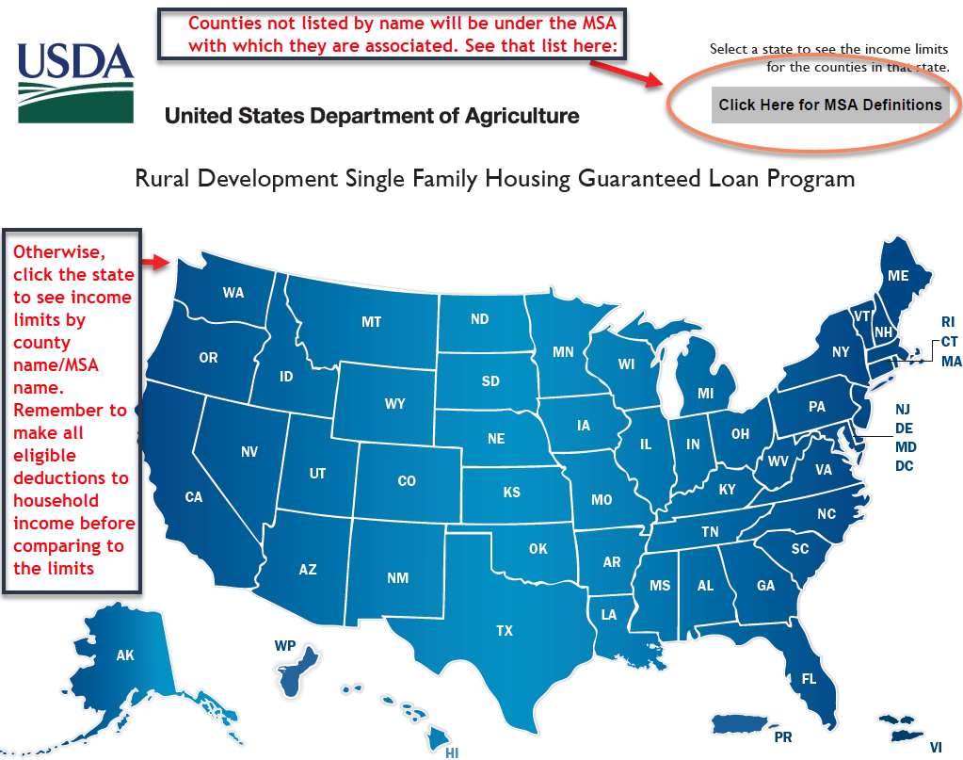
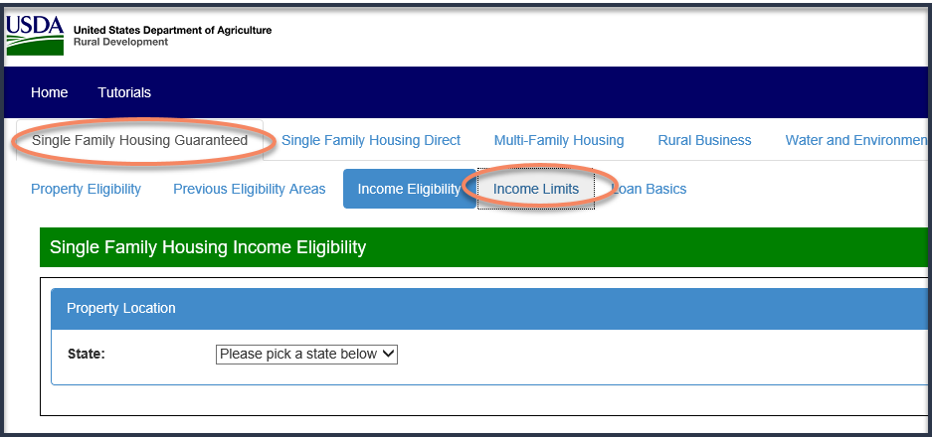
MAXIMUM INCOME LIMITS
https://eligibility.sc.egov.usda.gov/eligibility/welcomeAction.do
Notes:
Concerning the 2 statutory requirements (Income/Rural Areas), let’s look at Income Limits first. To find the Income Charts go to this website.
(The GUS system will also provide this information.)
Note the MSA Definition link – counties within MSA’s will not be listed by county name, but by MSA name.

Slide 18
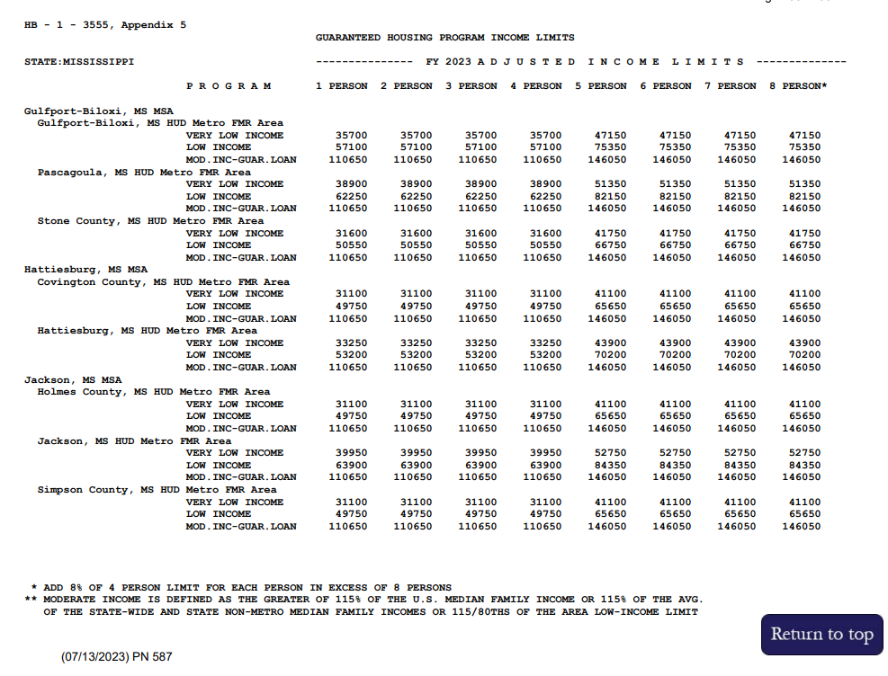
USDA RD programs have Maximum Income Limits for household size:
Notes:
Once you click the State name, this is an example of what you’ll see. Again, the example is for Missouri. As we discuss income, keep these maximum limits in mind.
The GRH program uses the MODERATE income limit. Notice the limits are the same for a Household size of 1-4 & the same for households of 5+ occupants. (There is a calculation for households in excess of 8 people -add 8% of 4 person limit for each person in excess of 8).
Direct is shown here to emphasize use of the LOW limits for that program & to show the difference between GRH & Direct limits.
The Guaranteed Underwriting System will provide results on Income qualifications, as well.

Slide 19
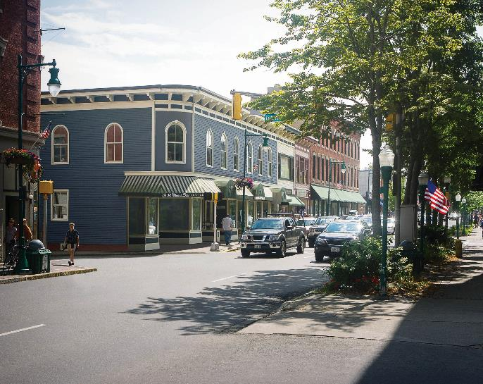
Rural Areas
Homes must be in a rural area, defined as a community with population of 35,000 or less. (Some cities of 20,000 or more are urban if they were classified as such as of October 1, 1990.)
To determine if an area is eligible, go to: https://eligibility.sc.egov.usda.gov/eligibility/welcomeAction.do?pageAction=sfpd
Notes:
State Offices determine the Rural Areas in their state.
The GUS system will also access the Property Eligibility website, but this website allows one to access this information without having to be in GUS.

Slide 20
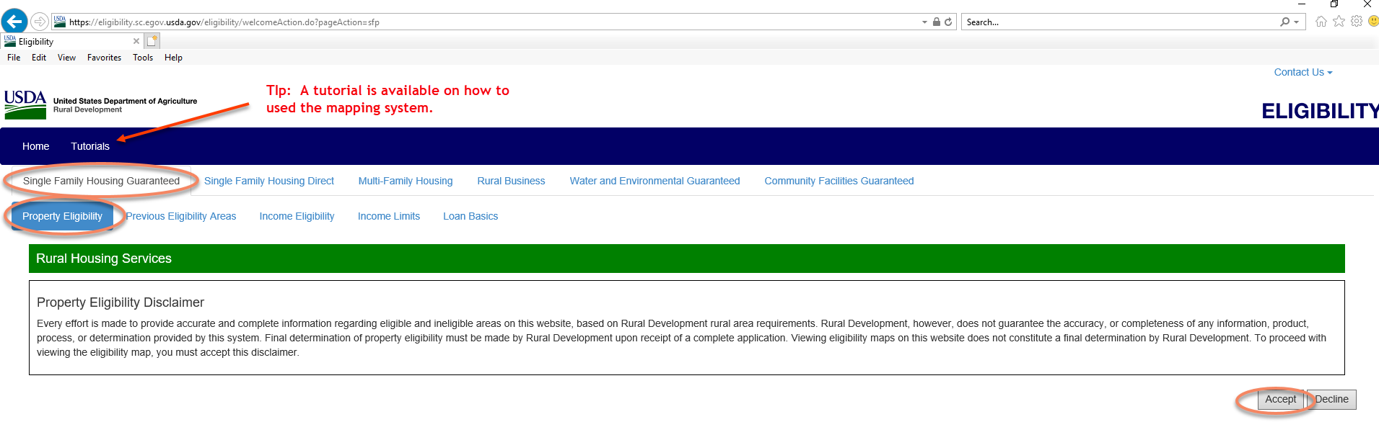
Rural Areas https://eligibility.sc.egov.usda.gov/eligibility/welcomeAction.do
Notes:
The GUS system will also access the Property Eligibility website, but this allows one to access this without having to be in GUS.

Slide 21
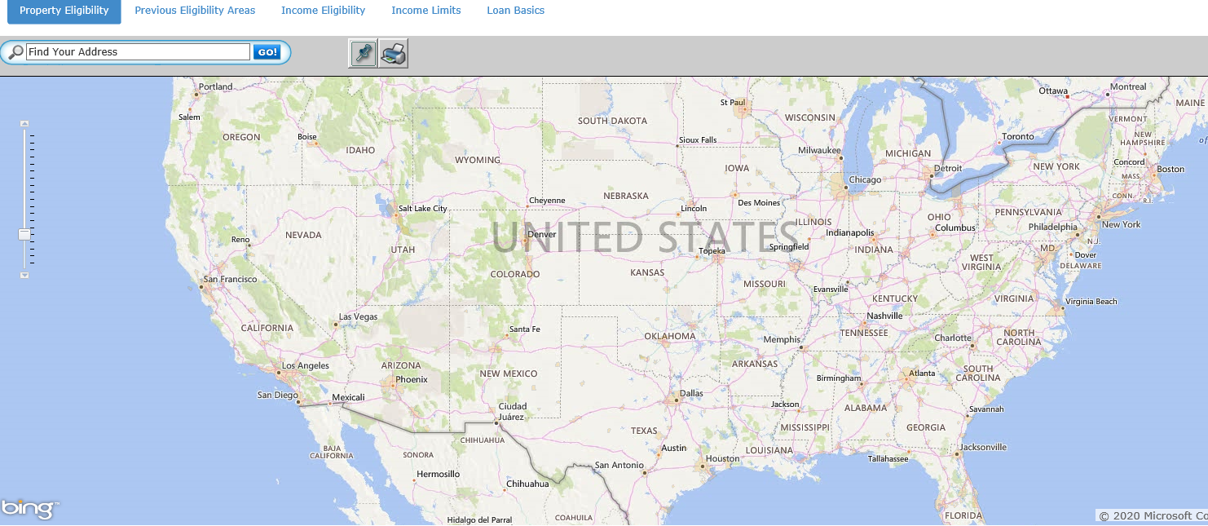
About USDA Rural Development - Rural Areas https://eligibility.sc.egov.usda.gov/eligibility/welcomeAction.do
‘Property Eligibility’ button

Slide 22
Olive Branch
Ineligible
Tupelo
Southaven
Eligible
Greenville
Columbus
Jackson
Vicksburg
Meridian
Flowood
Byram
Hattiesburg
Gulfport
Pascagoula
Biloxi

Slide 23
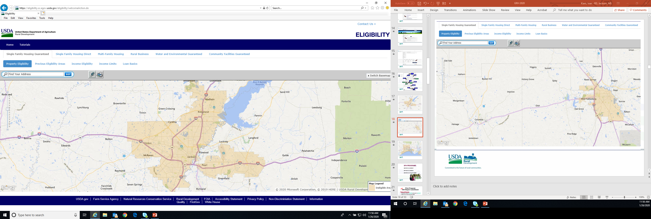

Slide 24
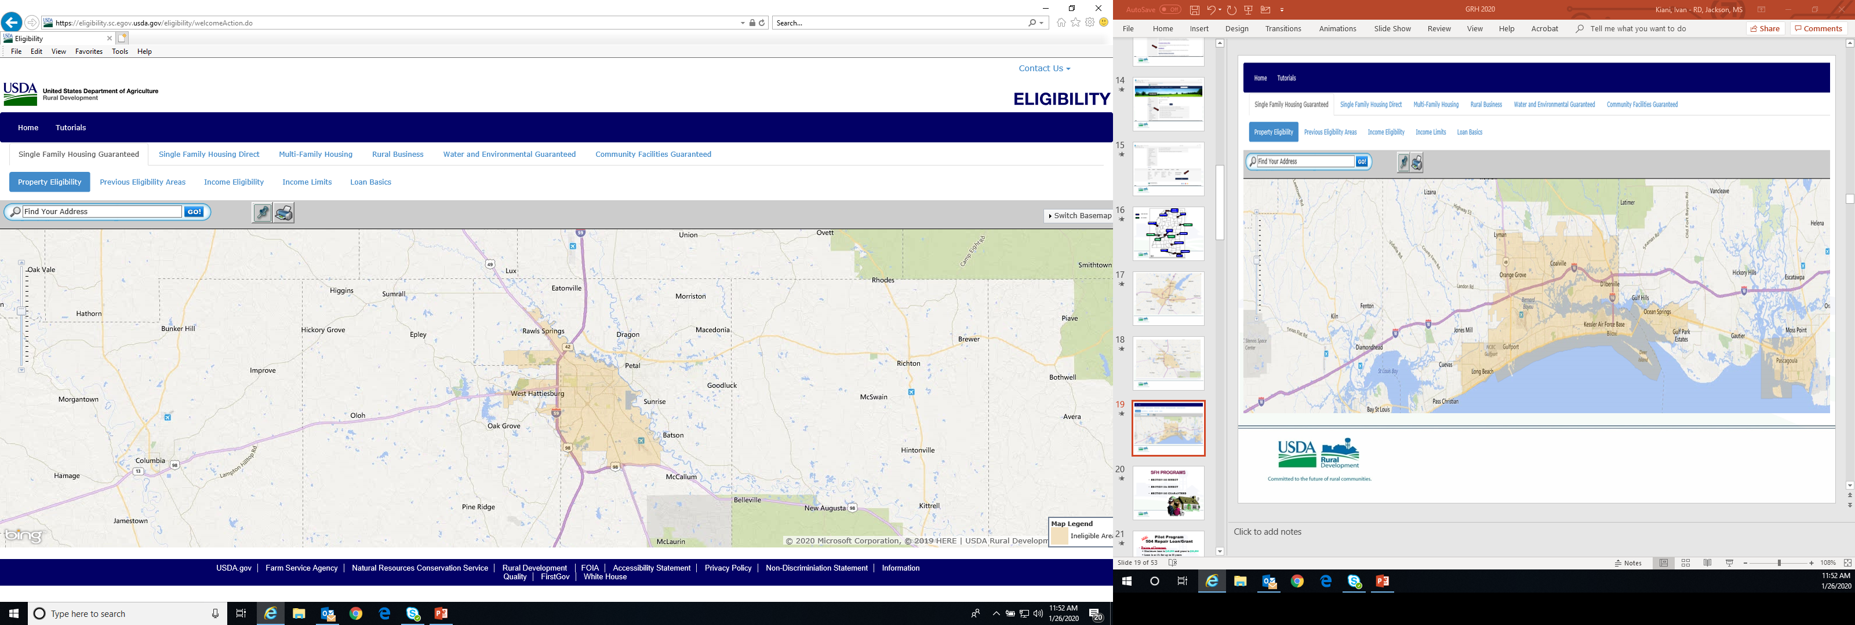

Slide 25
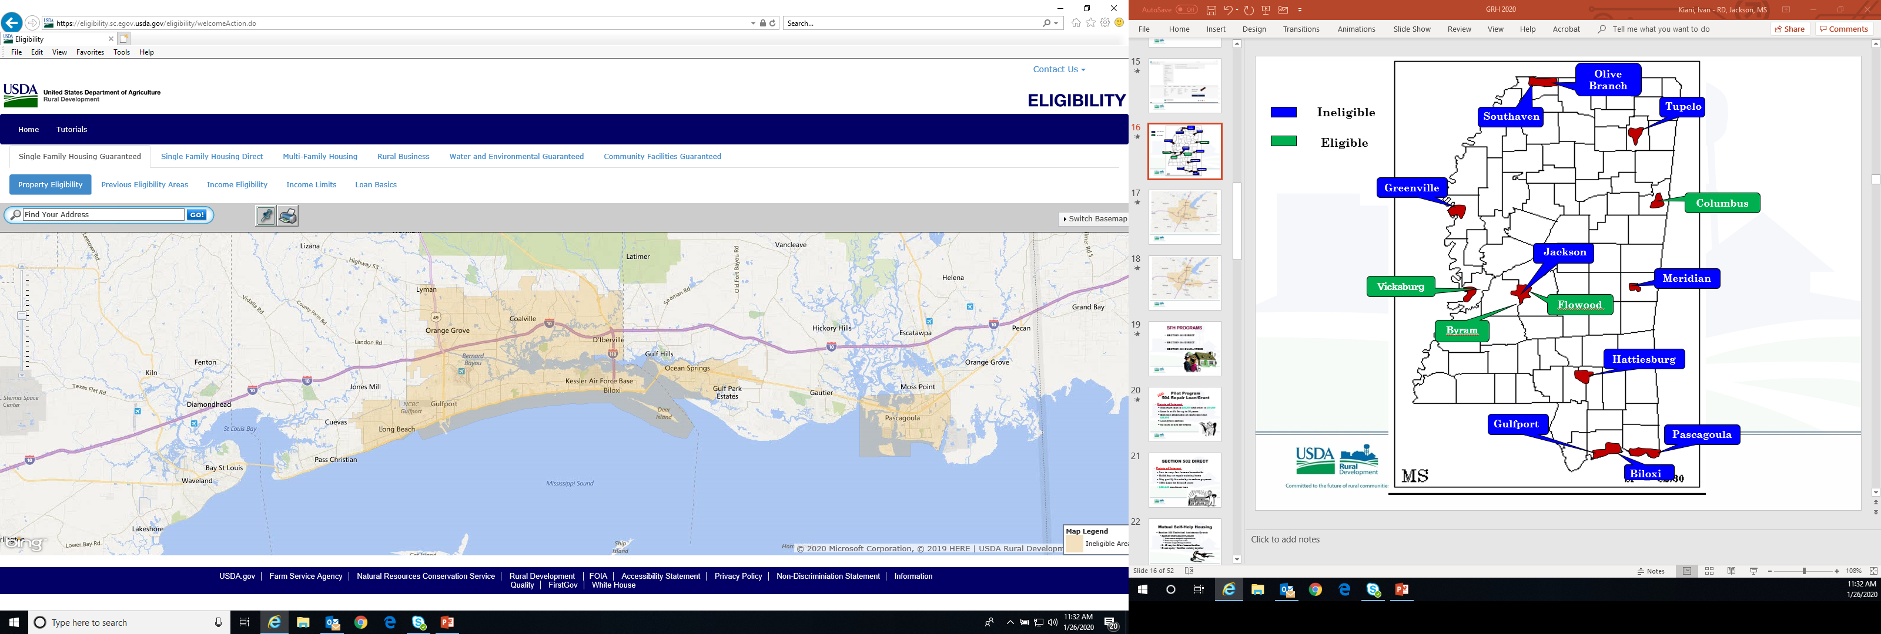

Slide 26
Rural Development
Single Family Housing
www.rd.usda.gov

Slide 27
SFH OBJECTIVE
“Provide moderate, low, and very-low income families who live in rural areas with an opportunity to affordably own adequate but modest and decent homes.”

Slide 28
LOAN PURPOSES
Acquiring dwelling & lot (new or existing dwelling)
Loans for new Construction loans
Repairs and rehabilitation when associated with the purchase of an existing dwelling – Loan can be backed from day 1 before the repairs are even started!
Reasonable and customary expenses associated with purchasing a dwelling (closing costs); and
Refinancing under specific situations
Notes:
(Extra info):
Repairs/Rehabilitation:
HB-1-3555, Chpt 12 contains specifics on establishing escrow accounts for Repairs conducted by the borrower (<$10,000 usually – para 12.9), and contractor-completed repairs (non-structural up to $35,000 and structural repairs exceeding $35,000 – para 12.28).
------------------------------------------------------------------------------------------------------
Refi’s include:
1 - “Take out” construction financing;
2 - Building lot when the new loan will also finance construction of a house and
3 - Existing Section 502 SFHGLP or direct loan program mortgage debt.
Borrowers are not eligible to receive “cash-out” from the refi transaction (except to reimburse them for eligible purposes). Also, refi’s cannot be used to refinance mortgage debt that is not guaranteed or insured by USDA (it has to be only Guaranteed or Direct loan debt). HB-1-3555, Chpt 6 has additional details.

Slide 29
APPLICANT ELIGIBILITY
Must be Income-eligible
Must be citizen or legal immigrant
Must occupy the property as principal residence
Dwelling financed must be ‘modest’, decent, safe & sanitary
Must not already own a home
  GRH program allows 1 other dwelling
Must have legal capacity
Must not have a suspension or debarment (check SAM.gov)
Must show repayment for the loan
Must have acceptable credit history
Notes:
The new definition of modest is a residence in which a low- to moderate-income borrower can afford (there are no longer maximum Loan Limits).
Repayment ratios=29/41 or approval by GUS.
FHA/VA are NOT considered conventional financing.

Slide 30
PROPERTY TYPES
What types of properties can be financed?
Existing Single Family Homes
New Construction – Proposed Construction
Townhomes
Condominiums (limitations apply including FHA/VA/Fannie or Freddie approval)
New Manufactured
  (Existing units after 2006 in some states under a pilot program)
New or existing Modular (treated same as site-built)
Duplex – 1 unit
Notes:
Manufactured home pilot: Colorado, Iowa, Louisiana, Michigan, Mississippi, Montana, Nevada, New Hampshire, New York, North Dakota, Ohio, Oregon, Pennsylvania, South Dakota, Tennessee, Texas, Utah, Vermont, Virginia, Washington, West Virginia, Wisconsin, and Wyoming

Slide 31
PROPERTY TYPES
Property must not be:
  Buildings designed & to be used principally for income producing purposes
  Income producing land

Slide 32


Single Family Housing
Section 502 Guaranteed Program

Slide 33
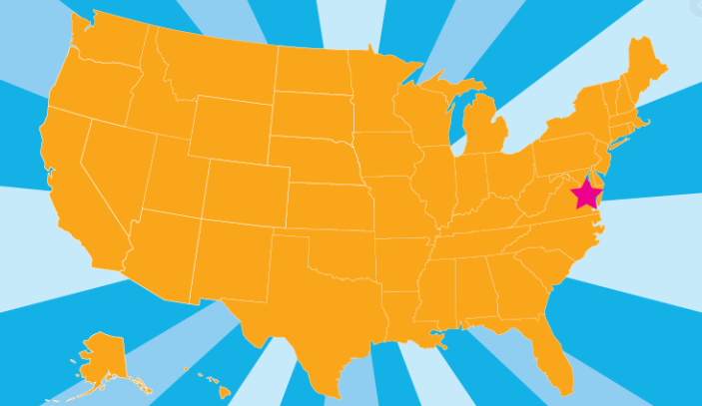
ABOUT USDA RURAL DEVELOPMENT
As of February 16, 2020, the Guaranteed Rural Housing program is now administered from the National Headquarters (NHQ) in Washington D.C.
Policy, Marketing, Quality Assurance, Lender Oversight and Production are now under the purview of NHQ. Previously, each state office controlled GRH operations within their borders.
Notes:
More efficient operation & greater consistency in delivering the program is the expected outcome.
Contact information is at the end of the presentation.

Slide 34


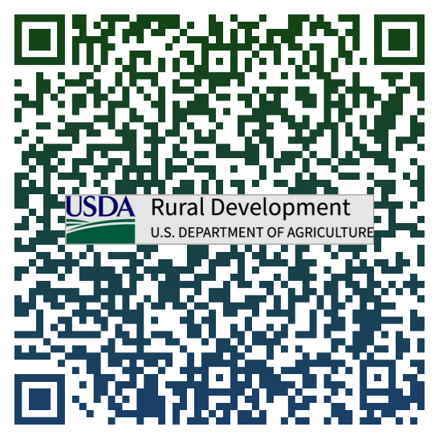

USDA Guaranteed Home Loans
USDA-Approved Lenders Make the Loan
No Down-payment (100% LTV)
For Low and Moderate-Income households
All construction types: New homes - Existing homes - Condos - Proposed construction - New Manufactured Homes – Existing Manufactured Homes in ‘pilot’ states
No purchase price limits
No monthly mortgage insurance (.35% annual fee)
Flexible qualifying ratios with 30 year Fixed-rate term
Two-tier income limits:
  1-4 person $110,650
  5-8 person $146,050
SCAN ME
Information Training
Contacts
Guidance

Slide 35
LENDER APPROVAL
HB-1-3555, Chpt 3 – Checklist: Attachment 3-A
To obtain USDA approval, must first be approved by:
HUD-FHA – supervised or non-supervised mortgagee (Direct Endorsement Authority, title II lending)
Fannie Mae/Freddie Mac (approved for single-family lending)
Ginnie Mae (is an issuer of their mortgage-backed securities)
VA (supervised or non-supervised mortgagee & authorized to close loans under VA’s automatic guaranty procedure)
State Housing Finance Agency (SHFA) – not automatic approval
Demonstrated ability to originate and/or service sound loans (see Chpt 3)
Notes:
Attachment 3-A is a Lender Approval Checklist

Slide 36
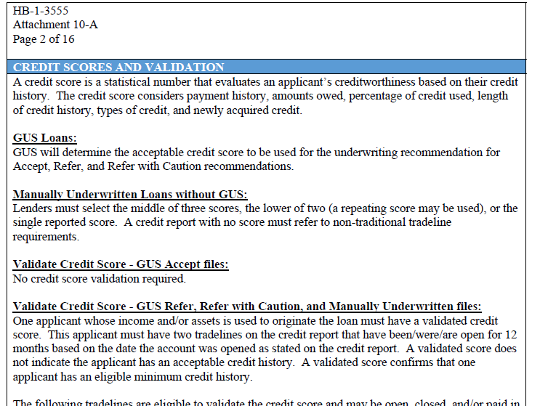
CREDIT MATRIX
HB-1-3555, Chpt 10, Attachment 10-A
Notes:
Just as there is an Income Matrix in Chpt 9, there is also a Credit Matrix in Chpt 10. It is Attachment 10-A & contains specific guidance that covers many topics related to Applicants’ credit histories.
Use it often – it will help you!

Slide 37

USDA Guaranteed Home Loans
LENDER RESOURCES
Training
Forms
Contacts
GovDelivery Updates
GUS Guidance
SCAN ME
Information Training
Contacts
Guidance

Slide 38
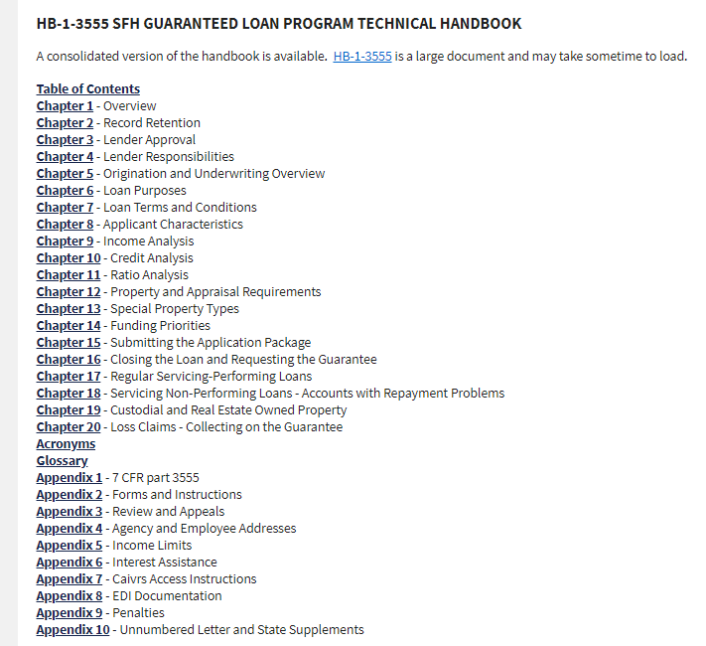

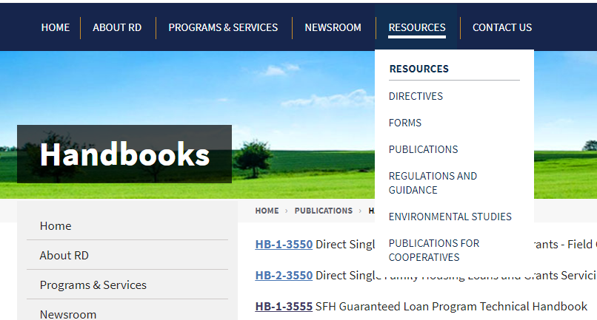
HB-1-3555
HB-1-3555 SFH Guaranteed Loan Program Technical Handbook
https://www.rd.usda.gov/publications/regulations-guidelines/handbooks
Notes:
The first place to look for program guidance always is the 7 CFR Part 3555 (which is Appendix 1 to our Handbook 3555); this is the regulations to administer the SFH Guaranteed Rural Program. The Handbook 1-3555 provides further guidance to the regulations. Usually, you can get answers to your questions by reviewing the corresponding information in the Handbook along with the Code of Federal Regulations.

Slide 39
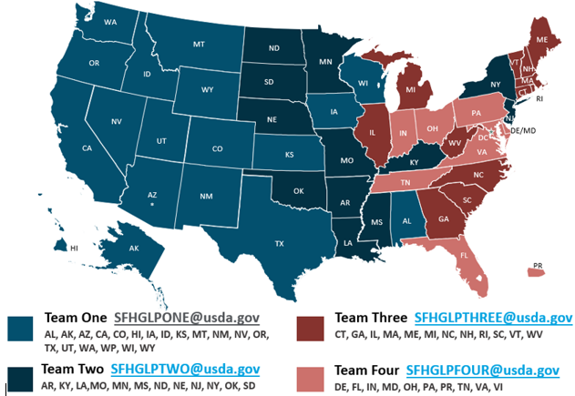
Production Teams
The GRH Team
General policy questions: sfhgld.program@usda.gov
The GRH Staff is now part of the Washington D.C. staff. Send file-specific questions & Manually Underwritten files to the appropriate team email Inbox:

Slide 40
Live Calls:
CALL USDA
(833)
314-0168
Option:
Turn Time Updates: 1
Specific File Questions: 2
Lender Recertifications/Approvals: 3
Policy & Scenario Questions: 4
GUS Technical Questions: 5

Slide 41
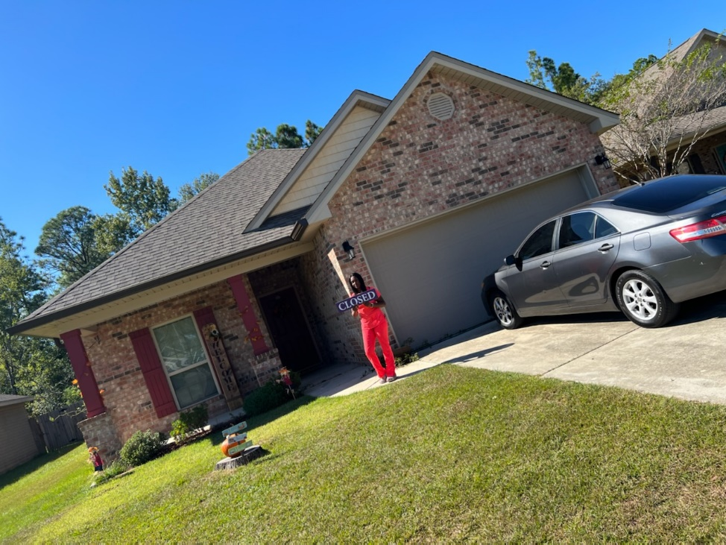
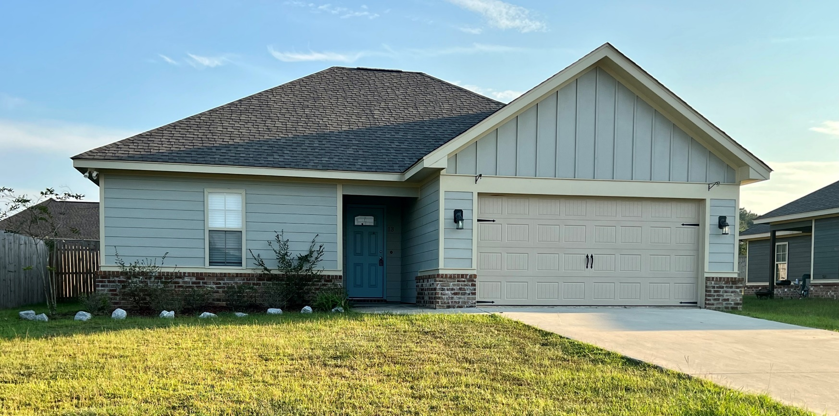
Single Family Housing
Section 502 Direct Program
https://www.rd.usda.gov/programs-services/single-family-housing-programs/single-family-housing-direct-home-loans

Slide 42

SECTION 502 DIRECT
Points of Interest
  Low to very- low income households
  Build, buy or repair existing home
  May qualify for subsidy to reduce payment
  100% Loan for 33 to 38 years
  $398,600 maximum loan

Slide 43

2023 Direct Adjusted Annual Income
Effective 7/13/2023
Two-tier income limits:
        1-4 person ranges $49,750-64,800
        5-8 person $65,650-85,550

Slide 44
Packaging low income
Home purchase Loans
Earn up to $1,750 per loan closing
Priority Status with USDA through Fahe as your Intermediary
Access to national set aside funds after state funds have been allocated
Support and training from Fahe’s 502 Mortgage Loan Specialist
Easy transition to expand your organization’s footprint and mission
How you can become a Qualified Employer/Packager:
Jamie Puckett
jpuckett@fahe.org 859.228.2112
www.justchoicelending.com/usda-502-packaging

Slide 45

Single Family Housing
Section 504 Direct Program
https://www.rd.usda.gov/programs-services/single-family-housing-programs/single-family-housing-repair-loans-grants

Slide 46
Section 504
Direct Loan/Grant
LOAN & GRANT PURPOSES
  Repair a dwelling to remove safety & health hazards and to improve the dwelling for a safer living environment.
62 years of age for a grant

Slide 47

504 Repair Loan/Grant
Points of Interest
  Maximum loan is $40,000 and grant is $10,000
  Loan is at 1% for up to 20 years
  Best lien obtainable on loans less than $25,000
  Loan/grant combos
  62 years of age for grants

Slide 48
Packaging very-low income
Home Repair Loans
Earn up to $750 per loan closing
Priority Funding Status with USDA
Access to national set aside funds after state funds have been allocated
Easy transition to expand your organization’s footprint and mission
How you can become a Qualified Employer/Packager:
Rural Development
Single Family Housing Division
Stefanie Granderson
Stefanie.Granderson@usda.gov or (601) 965-4325

Slide 49
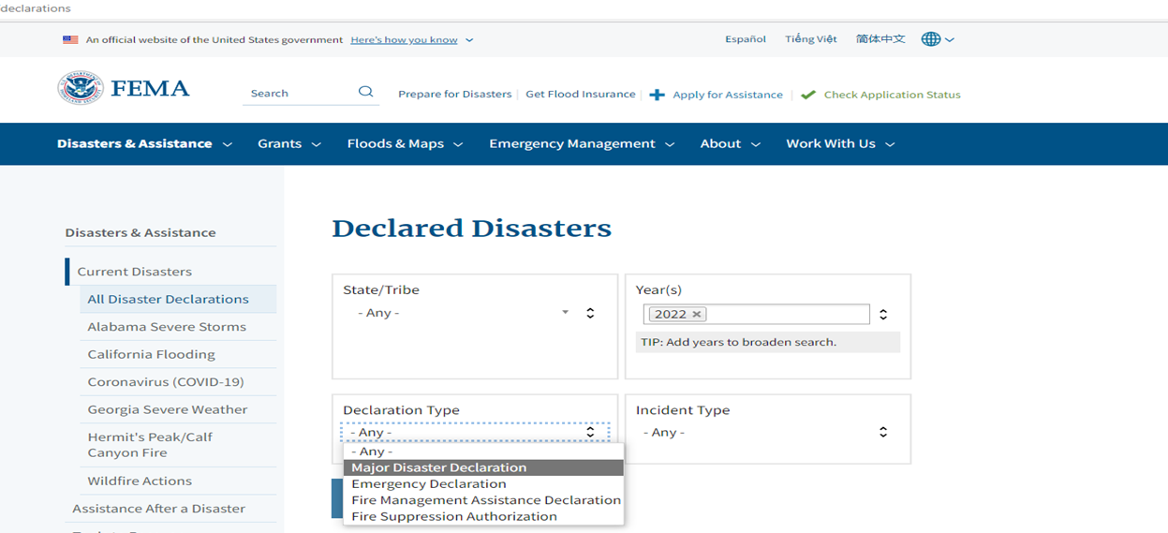
Disaster Repair Grants
Section 504 - Pilot
Presidentially Declared Disaster
  Jasper/Jackson counties declaration # 4727 June
Income must not exceed applicable very-low income
62 year age restriction does not apply
Maximum grant assistance of $42,920
Lifetime grant assistance
Damage must be directly associated with related storms
Good for one year from declaration date.

Slide 50

Disaster 504 Grants- Pilot
Eligible Grant Uses
  Disaster related home repair expenses incurred prior to application
  Site preparation
  Cost of moving a manufactured home
Occupancy
  Intended to coordinate with FEMA’s Individual Assistance Program
  Permanent housing solution must be anticipated with in 12 months or a permanent housing plan
Payment of materials prior to site delivery – must have paid itemized invoice
Notes:
Temporary authorizations continued.
Though prohibited in the Section 504 Grant Program, Disaster Grants can be used for:
Disaster related home repair expenses incurred prior to application so long as the needed repair was caused by the disaster.
Site preparation.
The cost of moving a manufactured home
Since the disaster may have forced the applicant into temporary living arrangements, the applicant does not have to occupy the property they own until the replacement housing is installed. These temporary authorizations are intended to help coordinate efforts with FEMA’s Individual Assistance Program to provide manufactured homes as replacement housing. A permanent housing solution on the applicant’s site must be anticipated within 12 months of application or a permanent housing plan must be provided if more than 12 months is anticipated.
Finally, the cost of materials can be paid to the contractor upon receipt of a paid invoice, or directly to the supplier, prior to site delivery.

Slide 51
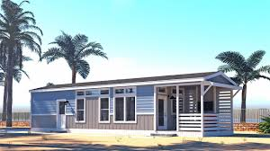
Existing Manufactured Housing Pilot Program
Existing manufactured Homes built on or after January 1, 2006
Must conform with federal Manufactured Home Construction and Safety Standards
Evidence of HUD Certification Label
Foundation design must meet HUD Handbook 4930.3 for permanent foundations
Unit must not have had any alterations from the factor (added porches, decks and/or other structures must be approved by local code officials)
Unit must have a floor area over 400 square feet
30 year term

Slide 52
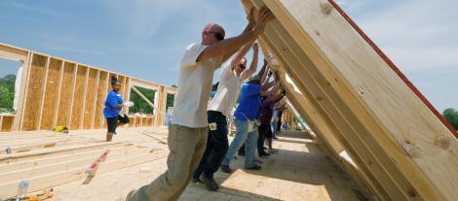
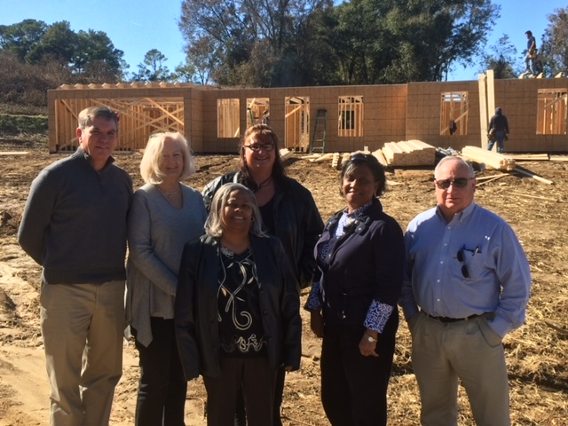
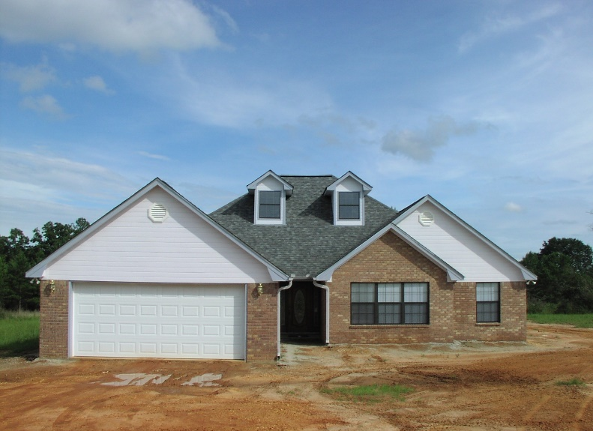
Single Family Housing
Section 523 Self-Help Housing Grants
https://www.rd.usda.gov/programs-services/single-family-housing-programs/rural-housing-site-loans

Slide 53
Single Family Housing
Section 523 Self-Help Housing Grants
Purpose
Provides grants to qualified organizations to help them carry out local self-help housing construction projects. Grant recipients supervise groups (minimum of 4) of very-low- and low-income individuals and families as they construct their own homes in rural areas. The group members provide most of the construction labor on each other’s homes, with technical assistance from the organization overseeing the project.
Eligibility
organization must be a non-profit, federally Recognized tribe and/or state or local
governmental entity.

Slide 54
Single Family Housing
Section 523 Self-Help Housing Grants
Grants average $300,000 to $500,000 plus
Dwelling constructed with 15% sweet equity
Dwelling financed with Direct 502 funds
Applicants help each other with building the neighborhood

Slide 55

Single Family Housing
Section 533 Housing Preservation Grant Program
https://www.rd.usda.gov/programs-services/single-family-housing-programs/housing-preservation-grants

Slide 56
Single Family Housing
Section 533 Housing Preservation Grant Program
Purpose – Provides grants to sponsoring organizations
for the repair or rehabilitation of housing occupied by
low and very-low-income families.
Eligibility – organization must be a non-profit, federally recognized tribe
and/or state or local governmental entity.
Advantages – provides grants or low interest loans to repair and rehabilitate
both homeowner and rental property owners. Includes administrative
expenses, labor and materials, handicap accessible features and the repair of
electrical wiring, foundations, roofs, heating systems and waste/water
disposal systems.

Slide 57

Single Family Housing
Section 524 Site Loans
https://www.rd.usda.gov/programs-services/single-family-housing-programs/rural-housing-site-loans

Slide 58
Single Family Housing
Section 524 Site Loans
Purpose
Rural Housing site loans provide two types of loans to purchase and develop housing sites for low- and moderate-income families:
Section 524 loans: are made to acquire and develop sites for low- or moderate-income families, with no restriction as to the method of construction.
Eligibility
Site loans are made to provide financing for the purchase and development of housing sites for low- and moderate-income families in eligible areas.
Loan Terms
  2-year loans
  Section 524 loans: below-market-rate established and published monthly, fixed at closing.

Slide 59

Updates
Most are delivered through:
GovDelivery (policy changes) and/or
Procedure Notices (PNs – procedure
changes)
Subscribe for program updates-by-email at:
https://public.govdelivery.com/accounts/USDARD/subscriber/topics?qsp=USDARD_25

Slide 60

Questions?

Slide 61

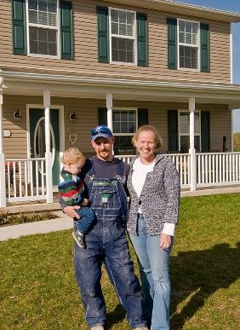
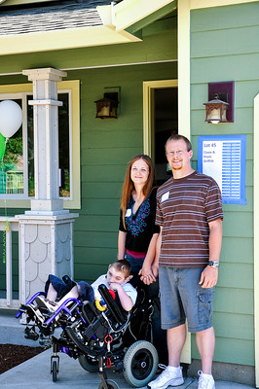
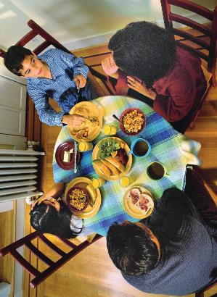


Notes:
Thank you for allowing me to take so much of your time today. I will answer any question via email because I have taken so much time. I will send a copy of this presentation and feel free to email me any questions you have.

